Slide 1
Online Community and Social Media
ELEG 491

Slide 2
What is Virtuality?
Online (virtual) communities
Virtual Reality (VR)
Online Presence (websites + storefronts)
Multi-player online games
This is not the “Matrix question”—whether reality is virtual, all the way down.

Slide 3
Online Communities
What is a Community?
Standard definitions usually refer to people living in the same place (town, city, etc.) and sharing (mostly) the same norms and laws.
With the Internet, our understanding of community has expanded to include online interactions, e.g., chat rooms, forums, games, and social networking sites such as Facebook.

Slide 4
The sociology of community
Traditional communities in Real Life (RL) are formed by religion, culture, language, labor sector, and sometimes even recreational interests
Online, people can decide to form a community out of shared interests and goals.

Slide 5
Early critiques of online communities
Borgmann: online communities compete with RL and cause disconnectedness and “diminished presence”
Dreyfus: anonymity online is without risk, hence one can’t build real relationships (even education!)
Contemporary critiques: online communities might support polarization, degenerate behavior, and in some cases criminality (Anonymous)

Slide 6
Some beneficial aspects of Online Communities (Etzioni)
Bonding/making new friends/partners
Proximity in space/time not required
Bridge geographic and national borders
Inclusive of homebound people (us!!!)
Accommodate more people
Safer than RL communities (in some sense)
Have stronger “memories”
Allow new relationships and “unconstrained” identities

Slide 7
Is Deception necessary for Online Communities?
Anonymity, psuedonymity, aliases, etc. are not typical features of RL
Revealing one’s true identity can now be risky online (identity theft, etc.)
Does this feature of online life “normalize” deception?
Plato’s “ring of Gyges” comparison: does anonymity cause immorality?

Slide 8
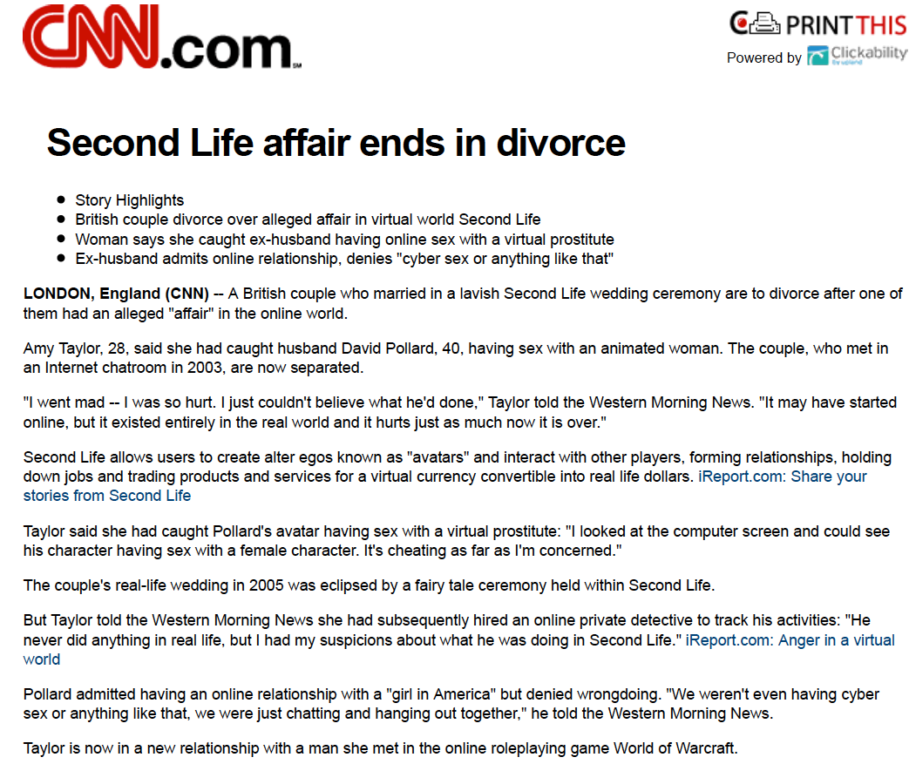

Slide 9
Ethical Aspects of Virtual Worlds
Is it wrong to perform acts in virtual worlds that (if real) would be considered immoral in “real life”?
Can we distinguish RL harm from virtual harm?

Slide 10
Ethics of virtual world gender bias and misrepresentation
Philip Brey argues there are representational issues in online communities, gaming, etc.
misrepresentations
biased representations
indecent representations.
According to Brey, these practices can hinder the moral development of those not subject to the faulty representations, as well as cause psychological harm to those who are subject to them.

Slide 11
The LambdaMOO case
Originally described in a Village Voice article by Julian Dibbell, this case inspired many in philosophy, sociology, and law.
See the Daily Beast article: The Original Internet Abuse Story: Julian Dibbell 20 Years After ‘A Rape in Cyberspace’

Slide 12
What was LambdaMOO?
A text-based MUD hosted by Xerox PARC
It is privately-owned but still considered a ‘public space’ (cf. Google, Facebook, etc.)
After the ‘New Direction’, the ‘wizards’ (programmers) adopted a hands-off attitude about behaviors and conflicts
The users of LambdaMOO were left with self-governance

Slide 13
Some facts about the incident
Virtual sex was often an activity of the MOO
The main avatars were frequent users, many students
The “rape” was extraordinary in its cruelty and violence
The ‘voodoo’ program used to immobilize the victims was part of the MOO
After the incident, a long discussion about governance arose between libertarians, anarchists, communitarians, etc. Bungle was toaded.

Slide 14
Some philosophical claims about the wrong done
Online speech is a form of action (Speech Act Theory) and thus ”real”
Identification or attachment between avatar and controller is key to understanding the wrong(s). So are reasonable expectations.
Whether text-based or graphical (3D) depictions matter to virtual morality is controversial (cf. Wolfendale)

Slide 15
What do you think about morality online?
On Facebook?
In Mutli-player games/E-sports?
In educational forums?
As a supplement to socio-political life?
As a replacement for socio-political life?

